Slide 1
GERD FOLLOWING SLEEVE GASTRECTOMY & RYGB: IS THERE A WAY TO PREVENT IT?
RELATORE : Dott. Antonio Buondonno
Chirurgia Generale Ospedale Cardarelli Di Campobasso

Slide 2
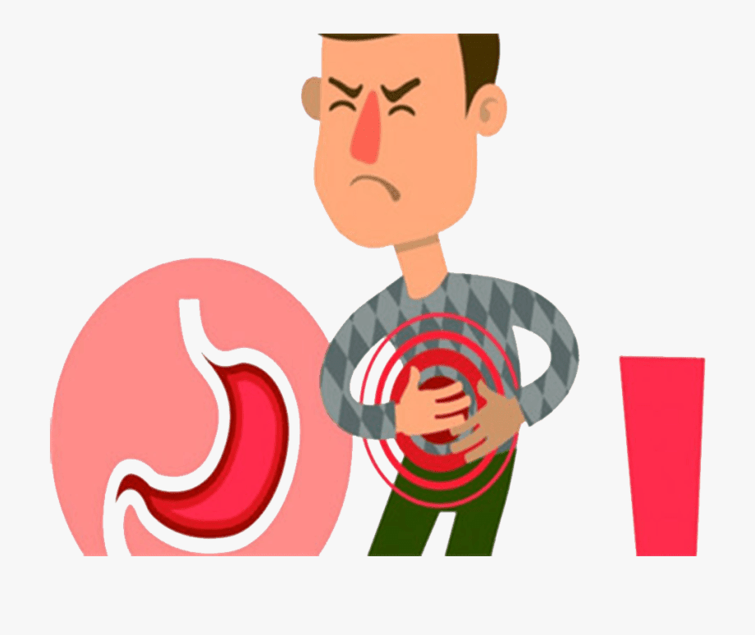
GERD
Gastroesophageal reflux disease (GERD), a known obesity-related complication, is a condition that occurs when reflux of stomach contents causes troublesome symptoms such as heart burn, regurgitation and chest pain

Slide 3
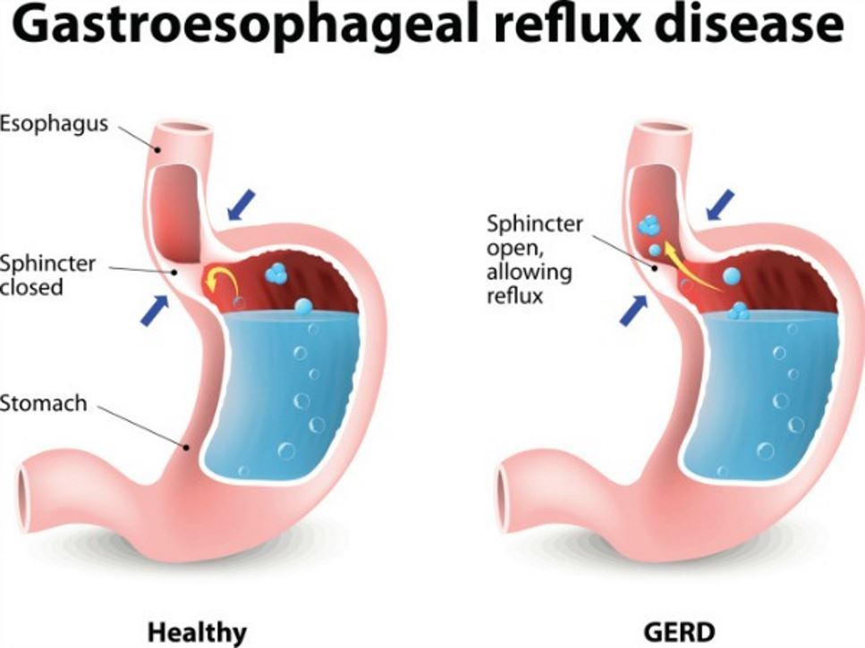
the global pooled prevalence of weekly gastroesophageal reflux symptoms is roughly 13%. Interestingly, the incidence of GERD in morbidly obese patient is up to 73%.

Slide 4
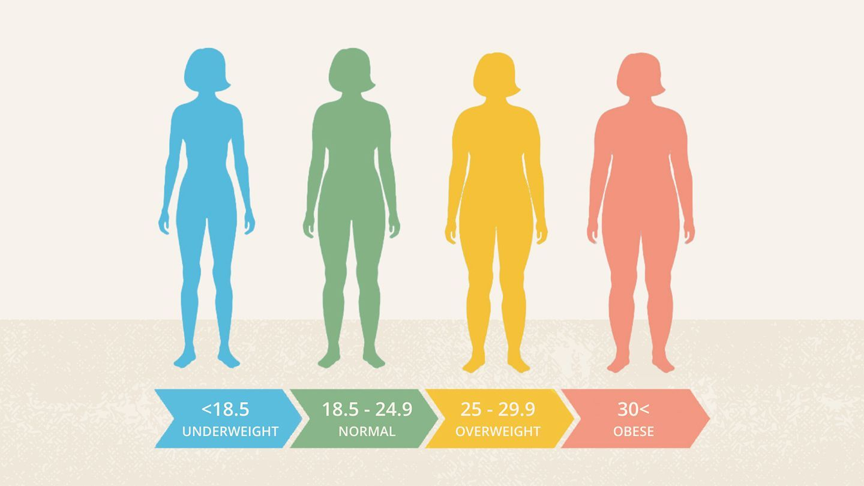
OBESITY
chronic disease
increase morbidity and mortality due to malignant cancer, cardiovascular diseases, diabetes, arterial hypertension, cerebral stroke, and locomotor system diseases
it leads to disability
reduces human life expectancy

Slide 5
more than one tenth of the word population are obese, including also children and adolescents
the fifth leading cause of death worldwide
Annually, nearly 3.4 million people die due to this disease
Pathophysiologic Mechanisms That Predispose Obese Patients to Reflux
Transient lower esophageal sphincter relaxations
Increased intra-abdominal pressure
Augmented gastroesophageal pressure gradient
Increased prevalence of hiatal hernia

Slide 6
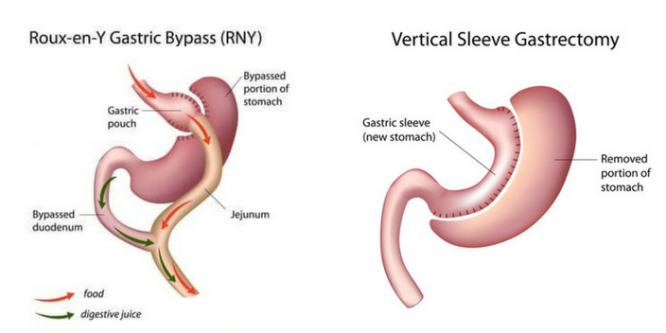
SLEEVE GASTRECTOMY AND RYGB

Slide 8
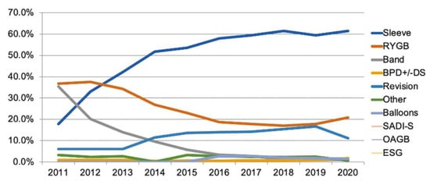
BMI 35-55

Slide 9
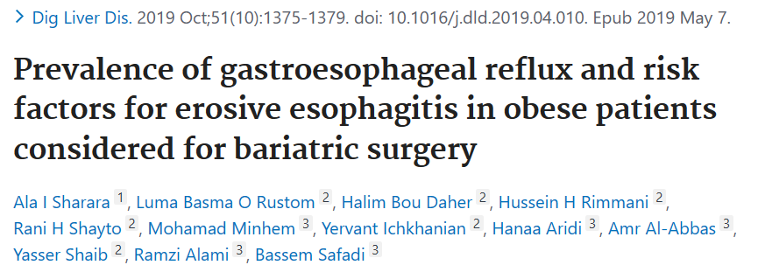
GERD VS BARIATRIC SURGERY
GERD has been reported in as many as 62.4% of bariatric surgery candidates

Slide 10
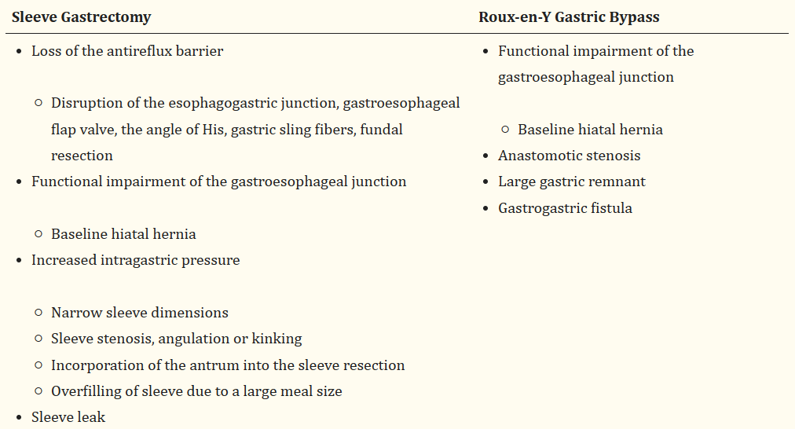

Slide 11
POSTSURGICAL COMPLICATIONS
Stenosis
Kinking
Angulation
Marginal ulcers
may lead to postoperative GERD and obstructive symptoms due to increased intragastric pressure and reflux of gastric contents
Endoscopic balloon

Slide 12
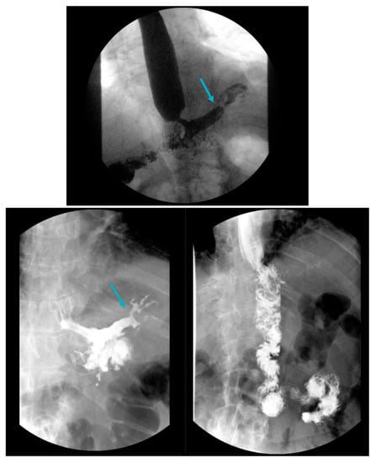
Gastrogastric (GG) fistulas are a serious complication that can occur in up to 6% of RYGB cases, and are often associated with abdominal pain, GERD and weight gain
Upper gastrointestinal series demonstrating a Roux-en-Y gastric bypass with a gastrogastric fistula and leak under the left hemidiaphragm (arrows, top and bottom left) as evidenced by contrast filling of an irregularly shaped cavity lateral to the gastric pouch, which spontaneously empties back via the gastric pouch. This patient eventually required a distal esophagectomy, total gastrectomy and esophagojejunostomy (bottom right).

Slide 13
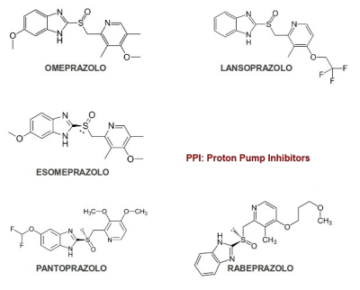
TREATMENT: LIFESTYLE MODIFICATIONS AFTER BS
diet protein-based food
Exercise
Avoidance of factors that exacerbate reflux (alcohol, tobacco, caffeine, chocolate and postprandial supination)
No Overfilling of the stomach with large meal portions
Dietary education
IPP

Slide 14
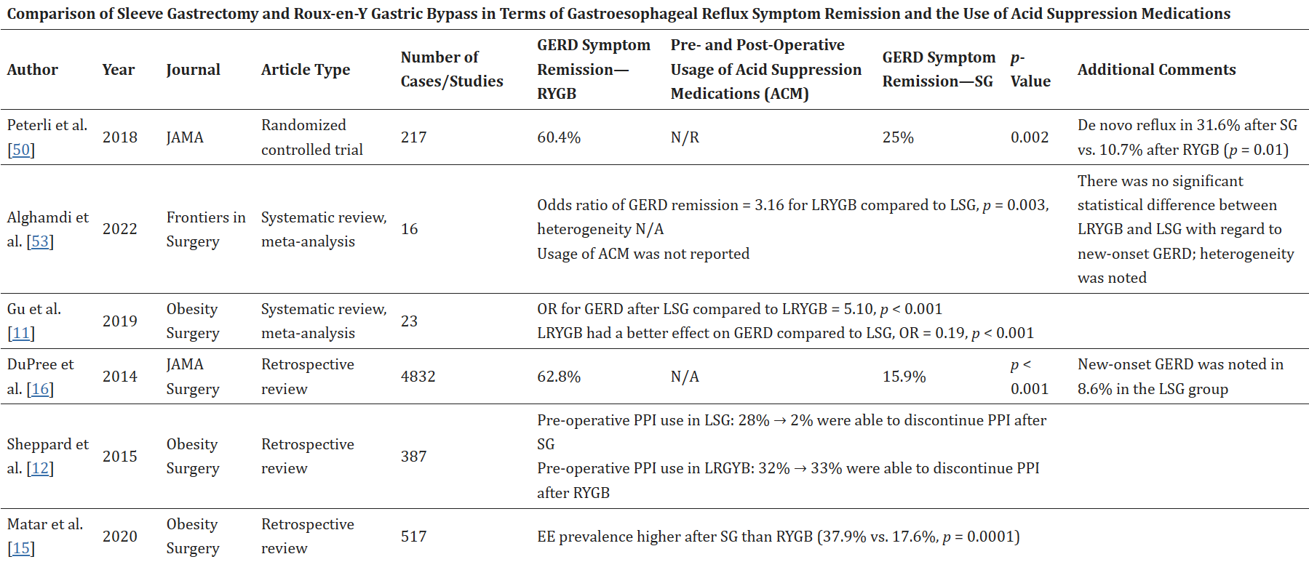
Literature comparison of sleeve gastrectomy and Roux-en-Y gastric bypass in terms of remission of gastroesophageal reflux symptoms and the use of acid suppression medications.

Slide 15
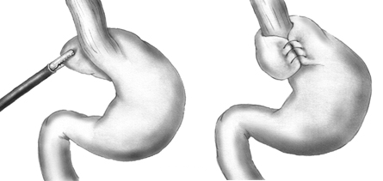
Sleeve gastrectomy has also been combined with fundoplication in an attempt to minimize postoperative GERD. In a randomized clinical study of 278 patients comparing SG to SG with Rossetti fundoplication (RF) in terms of de novo GERD, there was a significant reduction in PPI use (4.3% vs. 17.1%) and esophagitis (2% vs. 23.4) in the SG with RF group compared to the SG group

Slide 16
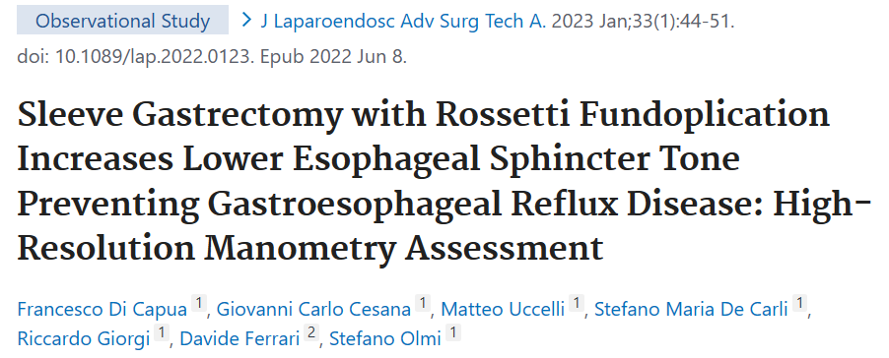
A significant increase in the lower esophageal sphincter tone was demonstrated on high-resolution esophageal manometry in 20 patients following LSG with RF, thereby potentially reducing the likelihood of developing long-term GERD

Slide 17
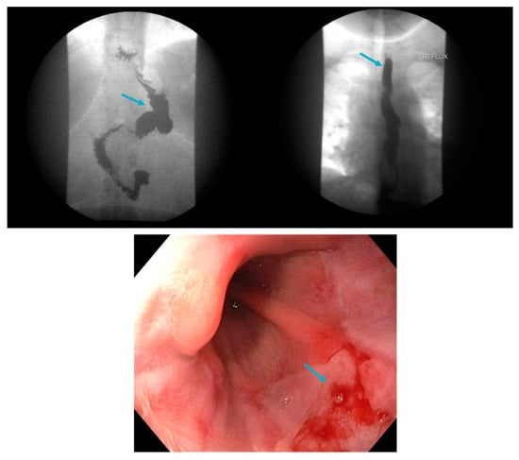
Ultimately, many patients require conversion from LSG to RYGB, which is highly effective in the treatment of post-bariatric surgery GERD
The literature has revealed a 5–10% conversion rate from LSG to RYGB due to GERD (HIATAL HERNIA)

Slide 18
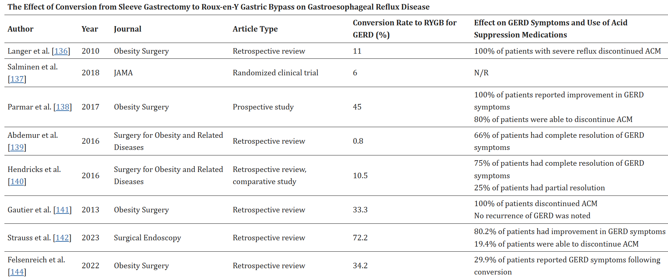
SL TO RYGB

Slide 19
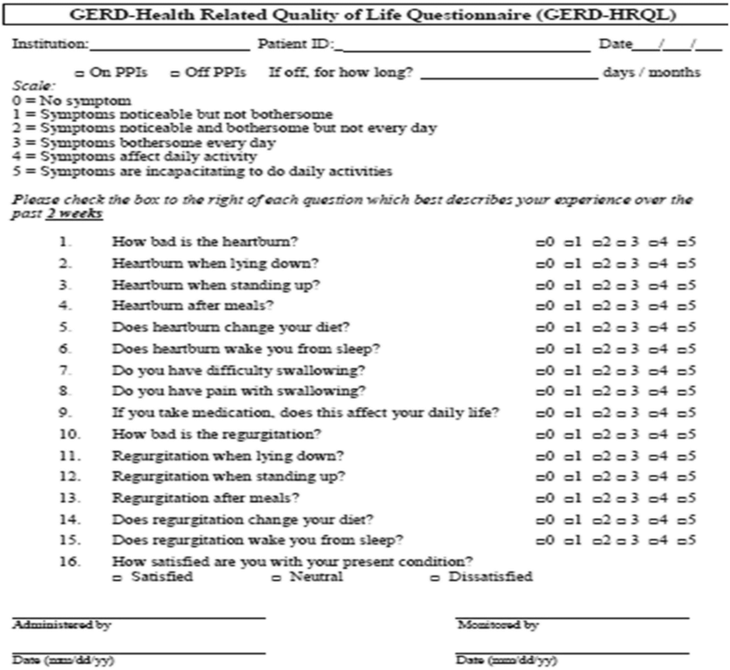
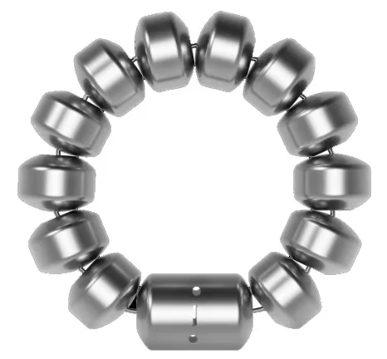
LINX©
A retrospective review of 13 identified patients who underwent LINX placement after bariatric surgery also noted decreased PPI usage post-operatively, reduced GERD-HRQL scores and relative safety of the procedure
MAGNETIC SPHINCTER AUGMENTATION DEVICES
Further data are needed to establish the safety and efficacy of magnetic sphincter augmentation devices following bariatric surgery

Slide 20
CONCLUSIONI
GERD is a common, chronic condition which can significantly impact quality of life and lead to serious complications. Obesity is a well-established risk factor for GERD, which often improves with weight loss and bariatric surgery. Management of post-bariatric surgery GERD includes lifestyle modifications, optimization of PPI and H2RAs, treatment of postoperative complications and repair of hiatal hernia if present.
Conversion to Roux-en-Y currently has the most robust evidence to support its safety and efficacy for the treatment of medically refractory GERD post-SG. Other options include magnetic sphincter augmentation, though data regarding safety and efficacy are limited.
Currently and going forward, more precise, standardized methods are warranted to document GERD following bariatric surgery, due to the variability in the reported literature. As bariatric surgery can be both the cure and the cause for GERD in the morbidly obese population, careful patient selection and proper surgical technique are paramount for a favorable outcome.

Slide 21
Dott. Marco D’Ambrosio

